Slide 1
Introduction to Computer Science (371-1-1601)
Lectures by: Dr. Dan Vilenchik & Dr. Zion Siksik
Recitations by: Ariel Cohen, Moshiko Davidian, Assaf Livne, Yair Mazal

Slide 2
Recitation 9a Linked Lists

Slide 3
Todays topics
Data structures:
Linked lists
Graphs & Binary Trees

Slide 4
FYI – first dry assignment in live
3% from the final grade
You have this week to do it.
However only 15 minute to finish it.
More precise details are in the Moodle.
Good luck

Slide 5
Motivation – Reminder on lists
Python lists are represented as continuous blocks in memory
If we want to make the block size larger, we have to re-allocate memory and copy the contents
Many times Python does this for us behind the scenes
Read more
H | E | L | L | O | W | O | R | L
H | E | L | L | O | W | O | R | L | D

Slide 6

Effects of reallocation
Pre-allocation of memory saves up to half of the time (see moodle example, modified from Stack Overflow), with respect to appending and extending.
Ignorant reallocation is terrible.
How bad can it get?
What if we cant pre-allocate?

Slide 7
List operations runtime:
Convenient to use, but what other option might we have?
Operation | Python’s list
Insert at beginning | O(n)
Insert at middle | O(n)
Remove from beginning | O(n)
Remove from middle | O(n)
Find k-th element | O(1)
Search unsorted | O(n)
Search sorted | O(log n)
Can we do better?

Slide 8
Linked Lists

Slide 9
Linked Lists
Each list element (called a node) contains data and a reference to the next node.
We hold a reference to the head to iterate over the list.
__head
__next
__next
__next
__next
None
__data
__data
__data
__data

Slide 10
Exercise #1
Use the provided node class to create a linked list

Slide 11
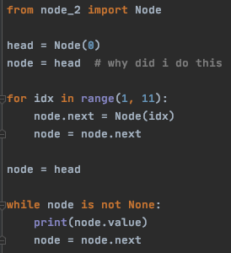
Exercise #1 - Solution
Maintaining a reference to the list head is imperative.
If the head is lost one cannot access the list

Slide 12
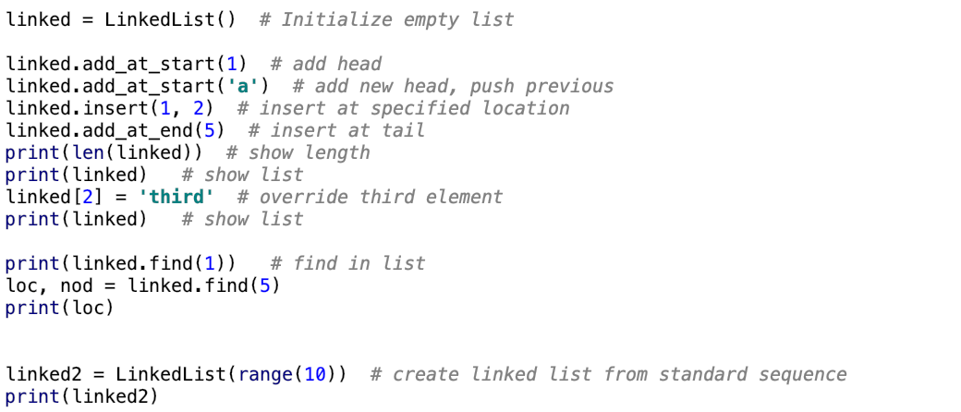
Some examples

Slide 13
Extensive Implementation - Reference
Method name | arguments | Use
__init__ | Seq – to initialize from sequence | initialize
__repr__ |  | To allow printing
__len__ |  | To provide length
add_at_start | Val – node value | Add element at head
add_at_end | Val – node value | Add element at tail
insert | Location, value | Insert element at given location
__getitem__ | Location | Provide interface for [] indexing
__setitem__ | Location, value | Provide interface for [] indexing
find | value | Find value in list
More methods in python file
Notes:
Just for refernce, dont go over

Slide 14
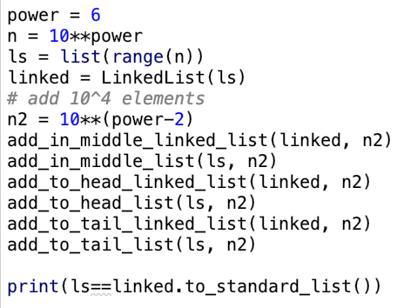
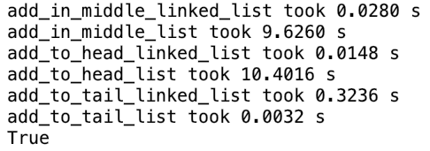
Did we save time?
Look at the time difference – standard list wins only when adding to the end

Slide 15
Complexity Analysis
Operation | Linked List | Python’s list
Insert at head
Insert at middle
Remove from head
Remove from middle
Find k-th element
Search unsorted
Search sorted

Slide 16
Complexity Analysis
Operation | Linked List | Python’s list
Insert at head | O(1) | O(n)
Insert at middle
Remove from head
Remove from middle
Find k-th element
Search unsorted
Search sorted

Slide 17
Complexity Analysis
Operation | Linked List | Python’s list
Insert at head | O(1) | O(n)
Insert at middle | O(n), O(1) given a reference | O(n)
Remove from head
Remove from middle
Find k-th element
Search unsorted
Search sorted

Slide 18
Complexity Analysis
Operation | Linked List | Python’s list
Insert at head | O(1) | O(n)
Insert at middle | O(n), O(1) given a reference | O(n)
Remove from head | O(1) | O(n)
Remove from middle
Find k-th element
Search unsorted
Search sorted

Slide 19
Complexity Analysis
Operation | Linked List | Python’s list
Insert at head | O(1) | O(n)
Insert at middle | O(n), O(1) given a reference | O(n)
Remove from head | O(1) | O(n)
Remove from middle | O(n), O(1) given a reference | O(n)
Find k-th element
Search unsorted
Search sorted

Slide 20
Complexity Analysis
Operation | Linked List | Python’s list
Insert at head | O(1) | O(n)
Insert at middle | O(n), O(1) given a reference | O(n)
Remove from head | O(1) | O(n)
Remove from middle | O(n), O(1) given a reference | O(n)
Find k-th element | O(k) | O(1)
Search unsorted
Search sorted

Slide 21
Complexity Analysis
Operation | Linked List | Python’s list
Insert at head | O(1) | O(n)
Insert at middle | O(n), O(1) given a reference | O(n)
Remove from head | O(1) | O(n)
Remove from middle | O(n), O(1) given a reference | O(n)
Find k-th element | O(k) | O(1)
Search unsorted | O(n) | O(n)
Search sorted

Slide 22
Complexity Analysis
Operation | Linked List | Python’s list
Insert at head | O(1) | O(n)
Insert at middle | O(n), O(1) given a reference | O(n)
Remove from head | O(1) | O(n)
Remove from middle | O(n), O(1) given a reference | O(n)
Find k-th element | O(k) | O(1)
Search unsorted | O(n) | O(n)
Search sorted | O(n) | O(log n)

Slide 23
Is this the only reason?
Aside then the fact that linked lists may be faster, they are much more flexible.
They allow us to construct more complex data structures:
Queues and stacks - Some other time
Graphs
Binary trees – Today!

